Slide 1
Ingress Controller
Written by Ted.J
jongnag@gmail.com

Slide 2
Types of Kubernetes & Relationship between them
Service
Pod
Ingress
Controller
Ingress
rule set
Endpoints
Ingress
Controller
Kubernetes API
monitoring
Ingress
(rule set)
Endpoints
NetworkPolicy
rules
Developers
switching between clusters by context
Limits
Region-asia1
(Resource, cpu/mem)
Cluster
Namespace
Pod
Headless service
Cluster
Namespace
Service
Pod
Container
StatefulSet
Federation
ClusterIP (internal)
--------------------------
Nodeport
Loadbalancer
ExternalName
Port proxy
Container
Cluster
(=context))
CPU
Cluster
(=context))
1:N
N:M
1:N
CPU
Region-asia2
GPU
(applications on stateful)
GPU
Mem
Mem
Ordinal index
Stable NetworkID
Stable Storage
Cluster
TLS(Certificate signing Request)
ConfigMap
Horizontal pod Autoscaler
(cpu,mem,custom)
sync controller by
federation controller manager
demonset
secret
configmap
Deployment
ReplicaSets
(stateless application)
Persistent
VolumeClaim
(Size,Mode)
(Stateless application)
Rollout & Rollback
Update image
Replicaset
Scaling a deployment
Pause & Resuming
* pod updating
Certificate
Signing
Requests
StorageClass
kubeadm join with token
-provisioner
Ceph/Gluster/AWS/
Ccloud/NFS/iSCSI
-parameter
(size, access mode)
(No NS)
Replication
Controller
Persistent
Volume
(No NS)
kubernetes
package
CoreDNS
Secret
Service
Account
Service
Account
Operator
ThirdPartyResources
Node
(Node selector)
Helm
DNS entry
Token
(kubeadm –ttl=0)
RBAC
ClusterRole
ClusterRole
Binding
Role
Binding
Role
DaemonSet
KubeDNS
rules
rules
service-name.namespace-name.svc.cluster.local
namespace or all namespaces
the same namespace
Job

Slide 3
The Purpose of Ingress* ?
Configure
an HTTP load balancer
for your Kubernetes services
Notes:
In Kubernetes, a controller is a control loop that watches the shared state of the cluster through the apiserver and makes changes attempting to move the current state towards the desired state

Slide 4
Relationship (Service <-> Ingress & Ingress Controller)
Service
Ingress Controller
Ingress
(rule set, how to access to service)
Notes:
In Kubernetes, a controller is a control loop that watches the shared state of the cluster through the apiserver and makes changes attempting to move the current state towards the desired state

Slide 5
What is Ingress?
: A set of rules
apiVersion: extensions/v1beta1 kind: Ingress metadata: name: my-ingress spec: rules: - host: www1.mysite.com http: paths: - path: /tea
backend: serviceName: greentea servicePort: 80
- path: /coffee
backend:
serviceName: redtea
service Port: 90 - host: forum.mysite.com http: paths: - path: backend: serviceName: forums servicePort: 80
Ingress resources
user request
www.mysite.com/tea -> service greentea
www.mysite.com/coffee -> service redtea
Kubernetes API
route
listening
ingress
controller
listening
matching
request
service
service
container
container
lifecycle
changing,
updating
Notes:
In Kubernetes, a controller is a control loop that watches the shared state of the cluster through the apiserver and makes changes attempting to move the current state towards the desired state

Slide 6
What is Ingress controller?
1) An application(= just a single container in a pod)
2) Monitors ingress resources (= a set of rules during the lifecycle of it)
3) Works with Kubernetes API
4) Update configuration of a load balancer in case of any changes
5) One of IGC: NGINX(static), NGINX Plus(dynamic)
 | NGINX | NGINX Plus
Reconfiguration | n/a | on the fly
Session persistence cache control app health check service discovery | (X) | (O) sticky cookie (client-> the same upstream server)
 | n/a | professional support
JSON web token | JWT (X) | (O)
 |  | certificate and key
clustering (active-active) | (X) | (O)
Media Delivery | HTTP Live Streaming(X) | (O)
Notes:
In Kubernetes, a controller is a control loop that watches the shared state of the cluster through the apiserver and makes changes attempting to move the current state towards the desired state

Slide 7
What type of resources does the Ingress controller can handle?
Ingress
controller
. In Action: exposing *services to public.
1. ClusterIP
2. LoadBalancer(cloud provider load balancer service)
3. NodePort (30000-32767)
4. ExternalName
. In general, Nginx , but possible HAProxy.
(can technically be capable of reverse proxying)
Service
deployment
service
replica set
replication controller
Notes:
In Kubernetes, a controller is a control loop that watches the shared state of the cluster through the apiserver and makes changes attempting to move the current state towards the desired state

Slide 8
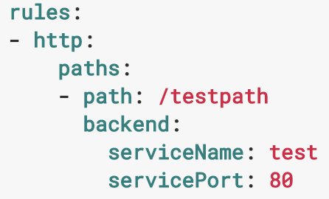
How it works?
load balance traffic, terminate SSL, name based virtual hosting
Edge router (H/W, S/W)
Ingress Controller
-> daemon,
-> handle ingress resources
-> pod (in terms of k8s)
Cluster
Ingress
Controller
annotation: nginx
Ingress
Controller
annotation: haproxy
Ingress
Controller
Ingress
Controller
annotation: gce
Ingress (a collection of rules, roles of set)
Node
Node
Node
service
service
service
allow inbound connections
to reach the cluster services
pod
pod
pod
<- incoming requests
(currently, http only)
Service

Slide 9
FYI, Working modes of kube-proxy
Userspace
iptables
ipvs(alpha)
client
api server
client
api server
client
api server
ServiceIP
(iptables)
kube-proxy
kube-proxy
ServiceIP
(iptables)
ServiceIP
(ivirtual server)
kube-proxy
Pod1
Pod2
Pod2
Pod1
Pod2
Pod2
Pod1
Pod2
Pod2
kubernetes master
service
endpoint
Notes:
ipvs(IP Virtual Server) use netfilter
IPVS implements transport-layer load balancing
communication between kernel and user space
benefits: That means ipvs redirects traffic can be much faster, and have much better performance when sync proxy rules

Slide 10
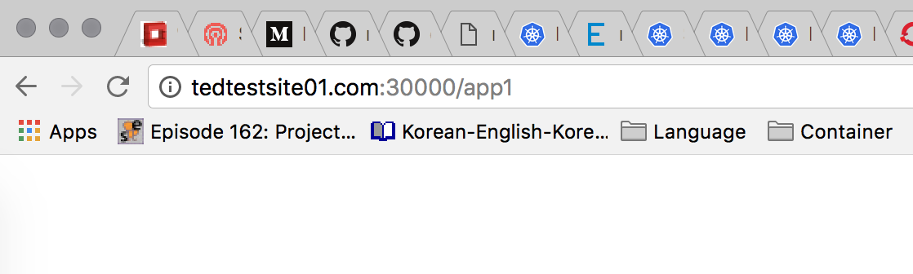
Demo
Ted’s Laptop
/etc/hosts
172.16.16.22 tedtestsite01.com
Ingress controller
(nginx)
Ingress
Service
Pod
Container
Pod
Container
Service
Pod
Container
Pod
Container
Annotation: nginx.ingress.kubernetes.io/rewrite-targetTarget URI where the traffic must be redirected
http://tedtestsite01.com:30000/app1
http://tedtestsite01.com:30000/app2
http://tedtestsite01.com:32000/nginx_status

Slide 11
Picture
www.ted.com
Kubernetes
rrDNS
LB(physical)
Ingress
pod
pod
pod
Ingress
LB(software)
Ingress
Ingress controller
www.ted.com
lb(physical)
lb(software)

